Slide 1

PS Remoting
Selling PS Remoting to your INFOSEC Team
Notes:
Foundational knowledge of Psremoting & logging
Cover everything you need to consider to understand remoting for shop
Make you confident enough to talk intelligently with infosec / mgmt / c-suite

Slide 2
Who am i?
Day Job: AD Engineer & PowerShell Fanatic
PowerShell.org: Director of Community Engagement
RTPSUG: Leader (@RTPSUG) - 1300 members strong!
Blog: www.networkadm.in
Writer: 4sysops.com & ipswitch.com
Contributor: PowerShell Conference Book vol. 1 & vol. 2
Twitter: @MikeKanakos
Email: mkanakos@gmail.com
GitHub: github.com/compwiz32
Notes:
What I do
Where you can find my articles
How you can contact me

Slide 3
Have YOU HEARD THIS yet in your org?
“I would like to enable PS Remoting for our computers…”
Are you crazy? PowerShell is used in all the malware attacks now… Why would we run this on our network?
What if we get owned? I don’t want an attacker having unlimited access in my network?
We will not allow running WINRM/Remoting on our network.
Notes:
How many people have been told by their security team that PSRemoting is not safe\not allowed?
Typical conversation with infosec and exec mgmt.
Teams don’t know how remoting works so its easier to say no.
Quick Story about Lord and PSRemoting
This is why I made this talk…

Slide 4
Who needs malware?
IBM says most hackers just PowerShell through boxes now, leaving little in the way of footprints
IBM's X-Force, found that in 2018 just 43 percent of the attacks it analyzed utilized any sort of locally installed files. Rather, the hackers utilized PowerShell scripts to execute their dirty deeds in memory without significantly touching file systems, if at all.
Notes:
Let’s talk malware trends
PS as an information gathering tool: Steal data and leave.

Slide 5
How is Powershell used by attackers?
Attackers mainly use PowerShell as a downloader and for lateral movement
Organizations often don’t enable monitoring and extended logging on their computers, making PowerShell threats harder to detect
Currently, most attackers do not use obfuscated PowerShell threats. Only eight percent of these threat families implemented obfuscation
Notes:
PS as a way to move around network
No logging
Powershell attacks in plain sight

Slide 6
So why do I need to know this?
Eliminate FUD
You need to know what runs on your network and how things run
Knowledge is Power!
Notes:
Ask:
A lot of misinformation about PSRmoting and PowerShell being unsafe. Most of it is wrong. PS conf book vol 2
Goal #1: Everyone gets ONE THING they can use tomorrow
Goal #2: Be able to talk confidently with your security team because you understand the process of remoting

Slide 7
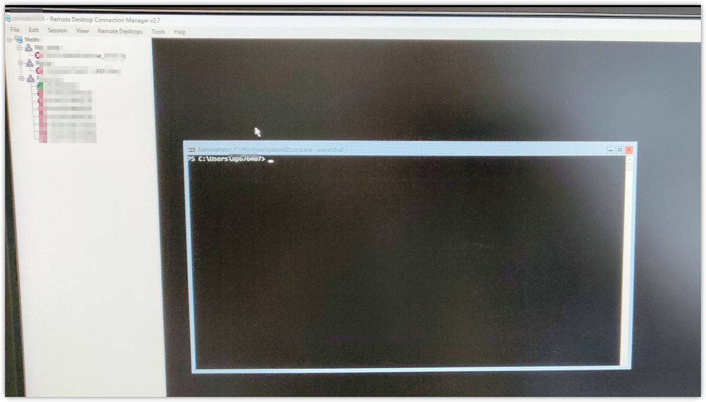
Not everyone has it figured it out yet….
Notes:
Server 2016 core…. Via RDP…
2016 core is cmd line only… so why RDP in when you can psremote in to the box?

Slide 8
How many slides do I have today?
47
Notes:
This stuff is easy for anyone to setup
No info on linux
Focus on Windows and AD domains

Slide 9
Agenda for today
What is PSRemoting?
Is it safe?
How does it work?
PowerShell Authentication
WMI vs CIM
How to Enable Remoting
Controlling Access to Remote Nodes
Logging PS Activity
Notes:
Start with foundational knowledge
Move on to things you can customize for your environment
Choices are not just binary….

Slide 10
What is PSRemoting?
PowerShell Remoting is a feature in PowerShell that lets admins securely run commands on remote systems
PS Remoting runs via the Windows Remote Management (WinRM) service
WinRM uses the Web Services for Management (WS-MAN) protocol to make secure, authenticated and encrypted connections between computers
WS-Man is an open standard for exchanging management data securely
Notes:
Let’s get everyone on the same page with some foundational knowledge
The one takeaway for this presentation:
PSREMOTING is safe

Slide 11
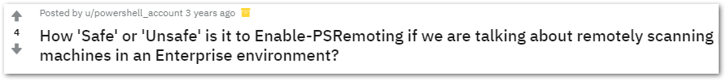
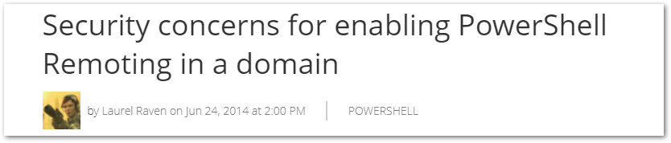
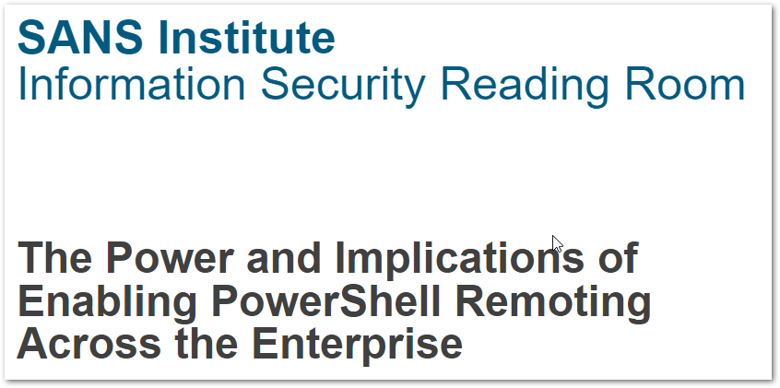
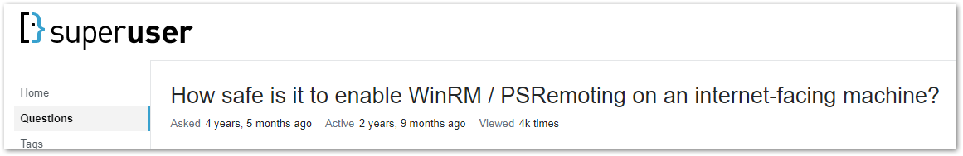
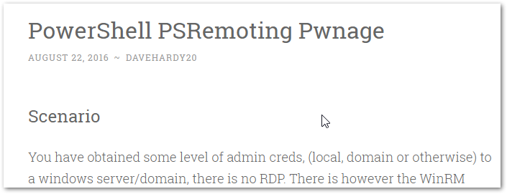
Is PSREMOTING SAFE?
Notes:
plenty of people want to know if remoting is safe
Much of the info on the internet is not correct
FUD

Slide 12
Is PSREMOTING SAFE?
Yes! …but why?
Authentication
Encryption
Logging/Auditing
Control (Constrained Delegation(JEA))
Notes:
Authenticate user and the computer w certificates
All connections are authenticated and encrypted
Log all activity if you want to
JEA – just enough administration
These 4 concepts make PS remoting secure

Slide 13
Quick demo!

Slide 14



PSREMOTING is the connection & HANDSHAKE between NODES….
Notes:
the road connecting two houses

Slide 15



How Does Psremoting work?
http 5985 / https 5986
Encrypted connection (256 bit key)
Local PowerShell session authenticates against remote client. - Enter-PSSession
- Invoke-Command
- Any CIM cmdlets
01
Commands typed on the local system are sent to a remote computer and executed locally ON THE REMOTE SYSTEM.
03
The remote system EXECUTES the commands locally and sends the results back to the local system.
04
Identity confirmed. Privileges granted based on local group membership
PS session on remote system via WS-MAN / WinRM
02
Notes:
Session NOT vpn tunnel
Cim cmdlets runspaces

Slide 16
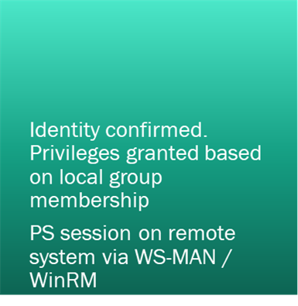
Powershell authentication
01
02
PS Remoting was designed to work with Active Directory
Authentication occurs using Kerberos for AD Domain-joined computers
Authentication occurs using NTLM for workgroup computers
Local PowerShell session authenticates against remote client. - Enter-PSSession
- Invoke-Command
- Any CIM cmdlets
Notes:
Ps remoting / AD works together
Kerberos: Core of AD security
Should be well trusted with security teams
NTLM for workgroups
Less secure but still authenticated

Slide 17
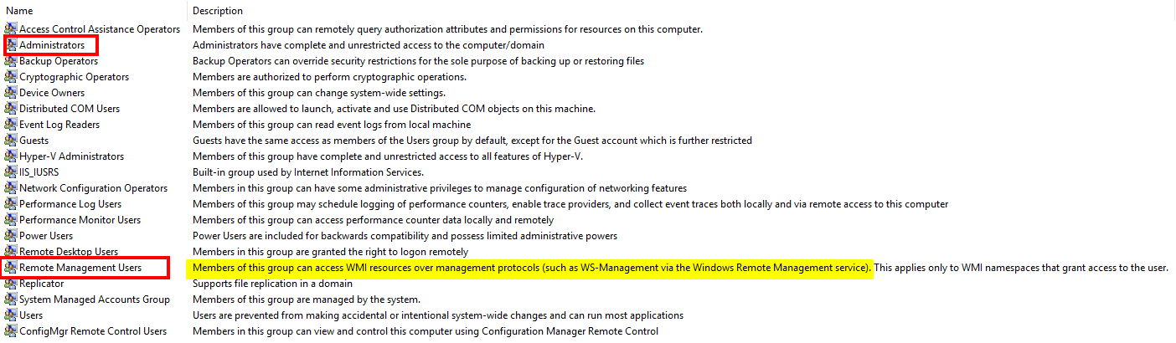
Powershell authentication
Notes:
Local machine security groups
Psremoting is designed for admins
Remote management users similar Remote Desktop users

Slide 18
CIM vs WMI: What’s the difference?
CIM is WMI and WMI is CIM. What? It’s confusing….
WMI is Microsoft’s version of an open standard called Common Information Model (aka CIM)
When CIM was created, there was no specification for networking
Notes:
Let me break it down for you

Slide 19
CIM vs WMI: What’s the difference?
Microsoft chose to use DCOM and RPC as the method to send and receive data. Their version of the standard was called WMI
In 2012, MS released a new version of WMI. But the knuckleheads didn’t give it a unique name!
This new version uses WS-MAN instead of DCOM & RPC.
It became known as CIM (or WinRM). The name stuck…
Notes:
DCOM and RPC not very secure

Slide 20
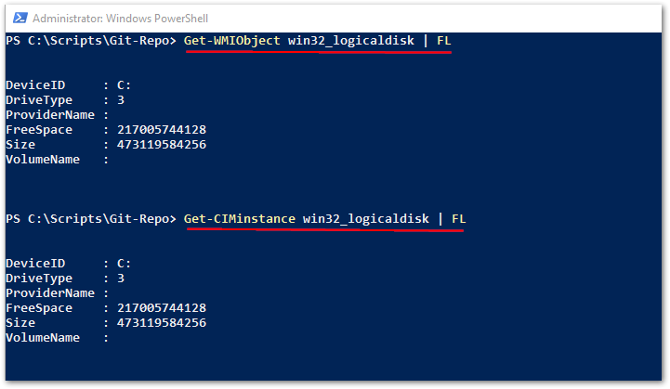
CIM vs WMI: What’s the difference?
Notes:
The data returned is exactly the same….
...how it gets transferred between computers is the only difference

Slide 21
CIM vs WMI: What’s the difference?
CIM:
Firewall friendly. Only needs 2 ports open
HTTP 5985, HTTPS 5986
Authentication via Kerberos
WS-MAN
WMI:
Not firewall friendly
TCP 135,445 must be open
Also, dynamic assigned ports between 1024 and 1034
DCOM & RPC
Notes:
Questions?
Everyone understand?

Slide 22
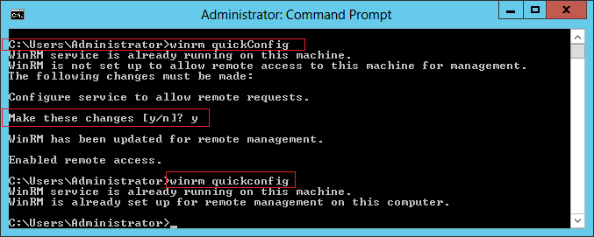
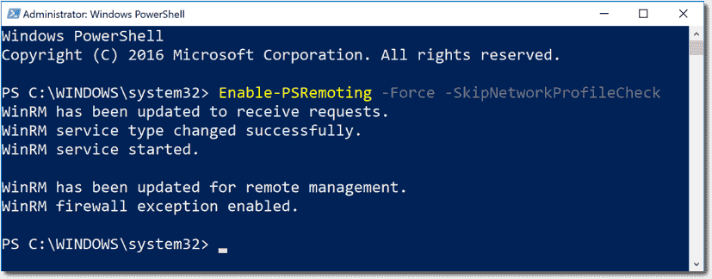
Enabling PSREMOTING VIA POWERSHELL
Notes:
Two methods to enable
One shows current config and then enables
Other just enables

Slide 23
Enabling PSREMOTING VIA GROUP POLICY
Enabling WINRM Service
Setting WINRM to Auto Start
Allow WinRM through the client firewall
Notes:
Via GPO ia how most people will do this…
3 steps – super simple

Slide 24
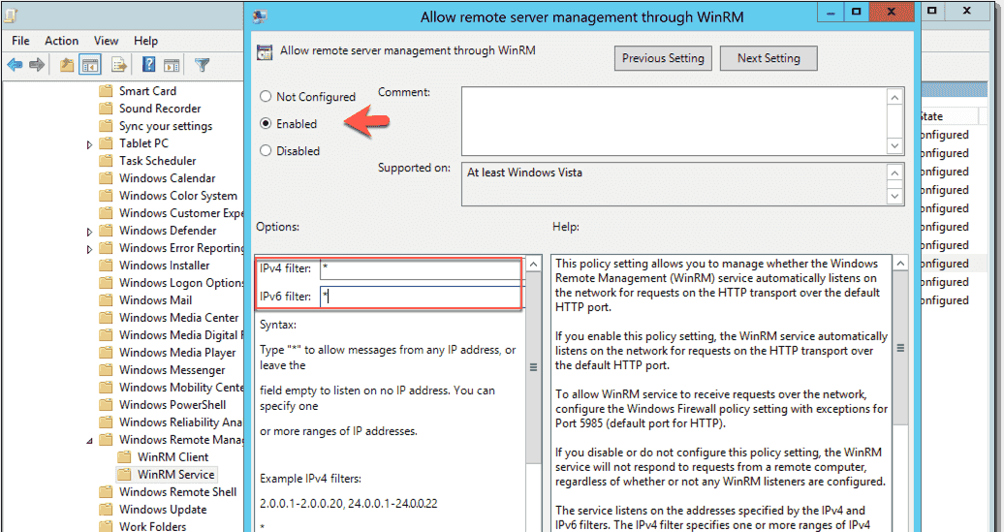
Enabling PSREMOTING VIA GROUP POLICY
Computer Configuration > Policies > Administrative Templates > Windows Components > Windows Remote Management (WinRM) > WinRM Service
Notes:
Enable remote management (enable /disable)
IP filtering… let’s come back to this…

Slide 25
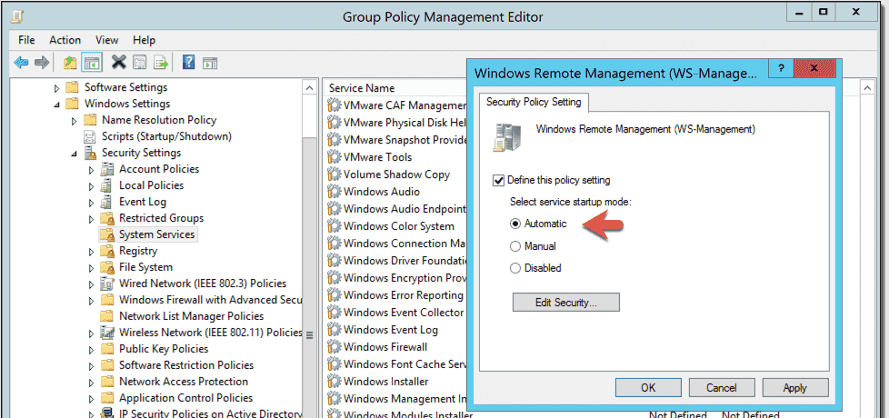
Enabling PSREMOTING VIA GROUP POLICY
Computer Configuration > Policies > Windows Settings > Security Settings > System Services > Windows Remote Management (WS-Management)
Notes:
Service startup - enable / disable

Slide 26
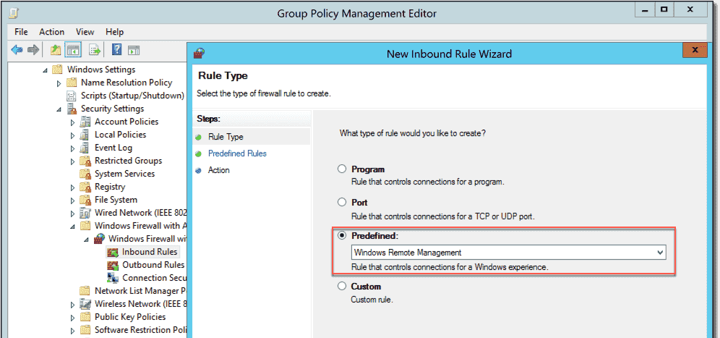
Enabling PSREMOTING VIA GROUP POLICY
Computer Configuration > Policies > Windows Settings > Security Settings > Windows Firewall with Advanced Security
Notes:
Poke a hole in firewall… super simple.. Predefined rule…

Slide 27
Controlling access to remote nodes
Remote Management Users = Read Access to client
Notes:
Read access
Populate the groups via GPO

Slide 28
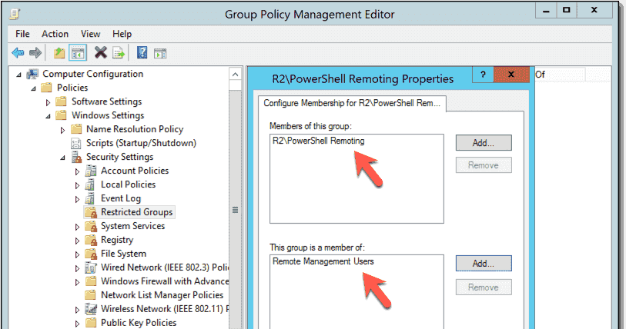
Controlling access to remote nodes
Computer Configuration > Policies > Security Settings > Restricted Groups
Notes:
Make an AD group (top box)
Add to an existing local group (bottom box)

Slide 29
PSRemoting & IP Filtering
Notes:
Enabling WINRM
Filtering IP sources (allow connections through firewall)
This is where it gets interesting…
Talk about jump boxes and clients that do not need to initiate connections
Combo of IP filtering at firewall and remote management users group is a powerful way to limit connections.

Slide 30
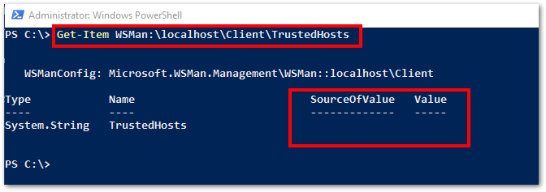
Trusted hosts
Notes:
List of machines I “trust” to connect to. By default it’s blank
Trusted hosts are set on the client, the system making the connection.
TrustedHhosts refers to the computers you trust to connect "TO", not the computers you trust to receive connections "FROM". And yes, it seems counterintuitive. Why limit yourself to connecting only to machines listed in TrustedHosts? As long as you are using Kerberos authentication within a domain, there is no need for TrustedHosts, because Kerberos provides mutual authentication and assures that your credentials are never passed to a machine outside your trusted domain(s).
However, with other types of authentication, there is no guarantee the computer you connect to is not an evil machine that someone smuggled into your network. If you provide your credentials to such a machine, it could grab them and do bad things with them.
This is why, by default, Windows PowerShell Remoting does not allow connections to these machines and leaves it to you to reduce security by adding exceptions to TrustedHosts. <<<

Slide 31
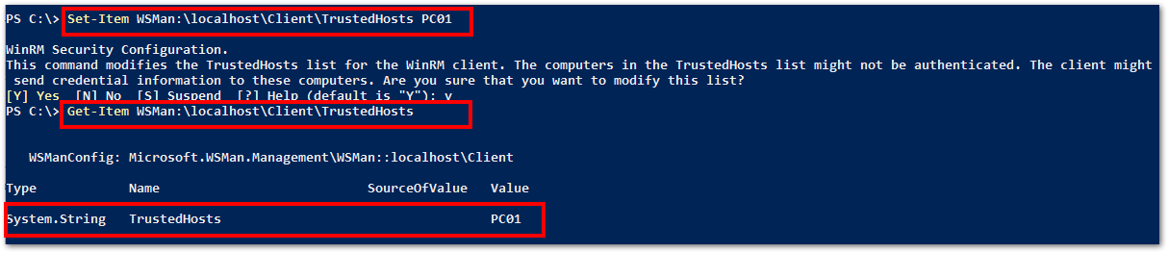
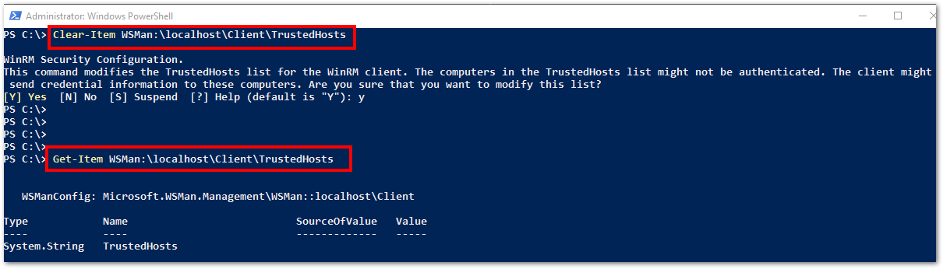
Trusted hosts
Notes:
Comma seperated list of hosts

Slide 32
Enabling PSREMOTING: Summary
Enable WINRM Service and set to auto start
Configure Windows Firewall Exception
Decide who gets access
Decide where connections can be initiated from
Decide how you will do all of above (cmd line / GPO or both)
Notes:
Knowing this process builds trust
Trust allows the security team or exec mgmt to do the things you ask for

Slide 33
PS REMOTING: What ELSE?
I’ve talked almost exclusively about authenticating users
SSL & certs verify computer identities
JEA is next logical step
SSL & Certificates allow PowerShell remoting to use HTTPS port 5986 in addition to HTTP port 5985
Logging activity is critical for understanding what is happening
Notes:
And that leads to me to part 2 of this presentation….

Slide 34
Powershell Logging
Module Logging
Script Block Logging
Transcription
Notes:
No right combination of settings by default.
You have to figure whats right for you and your org

Slide 35

Powershell Logging: Module LogginG
Module logging grabs activity related to specific modules Example: logging all activity from the Active Directory Module cmdlets
Events are written to the Windows PowerShell log
Can produce a large volume of events. Increase log size to 1 GB if possible

Slide 36
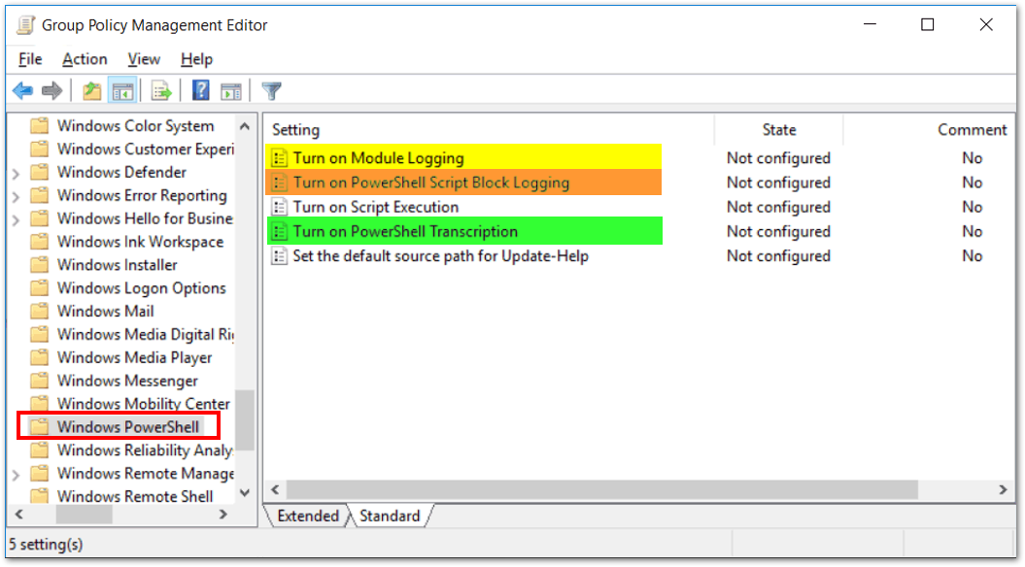
Powershell Logging: Module LogginG
Computer Configuration > Policies > Administrative Templates > Windows Components > Windows PowerShell

Slide 37
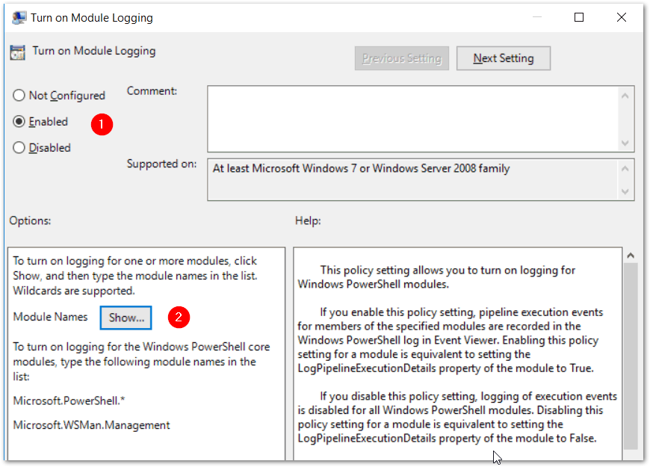
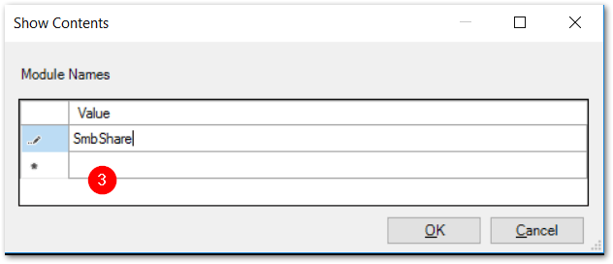
Powershell Logging: Module LogginG

Slide 38
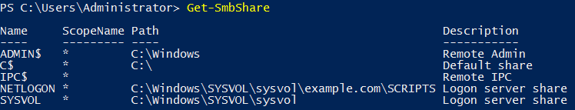
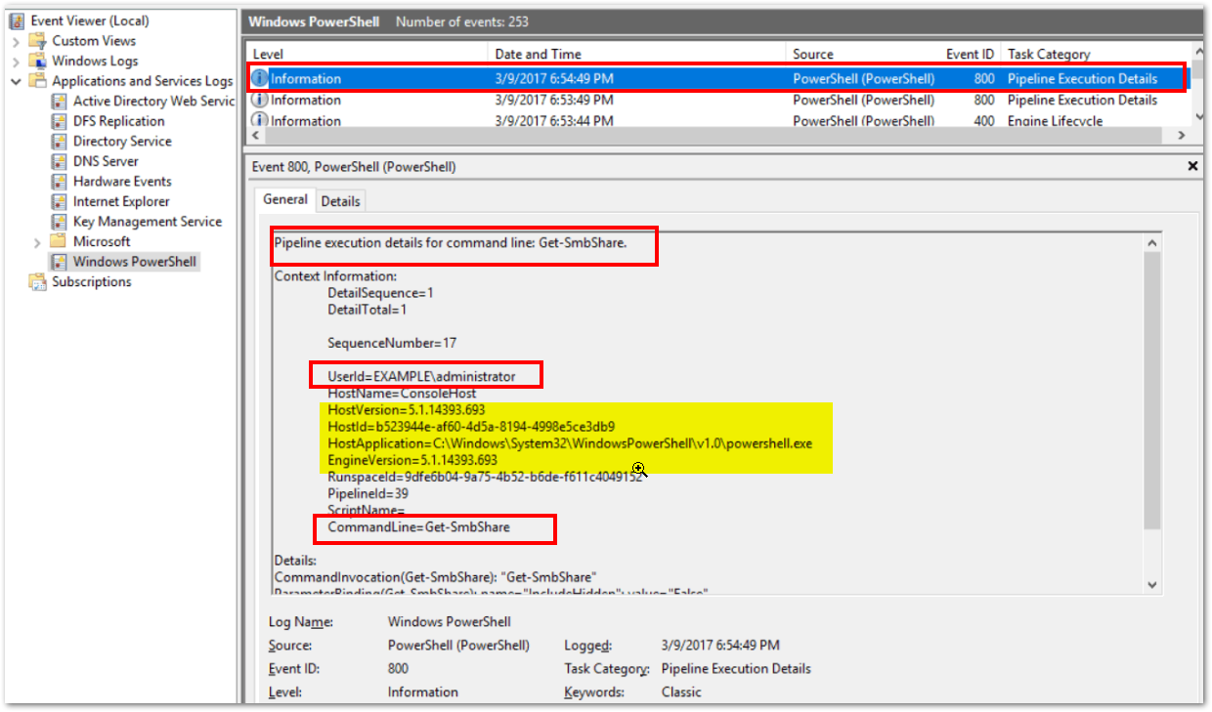
Powershell Logging: Module LogginG

Slide 39

Powershell Logging: Script block LogginG
Script Block logging records blocks of code as they are executed by the PowerShell engine
Events are written to the Windows PowerShell log (Event IDs# 4104, 4105 & 4106)
PowerShell 5.0 automatically logs code blocks if the block’s contents match on a list of suspicious commands or scripting techniques, even if script block logging is not enabled.
Produces less logs than Module Logging but still can be noisy.

Slide 40
Powershell Logging: SCRIPT block Logging
Computer Configuration > Policies > Administrative Templates > Windows Components > Windows PowerShell

Slide 41
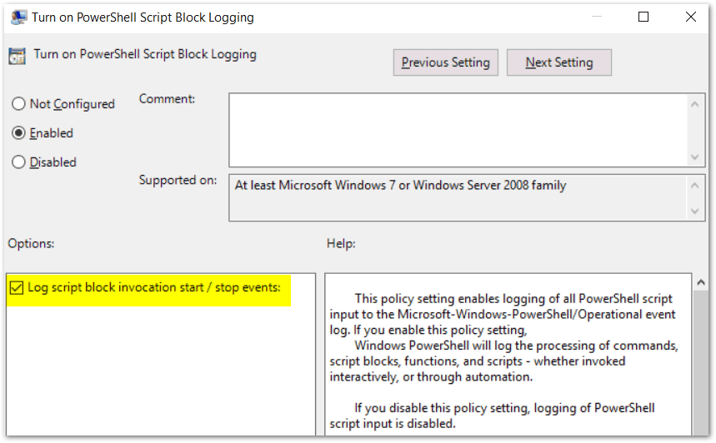
Powershell Logging: SCRIPT block Logging

Slide 42
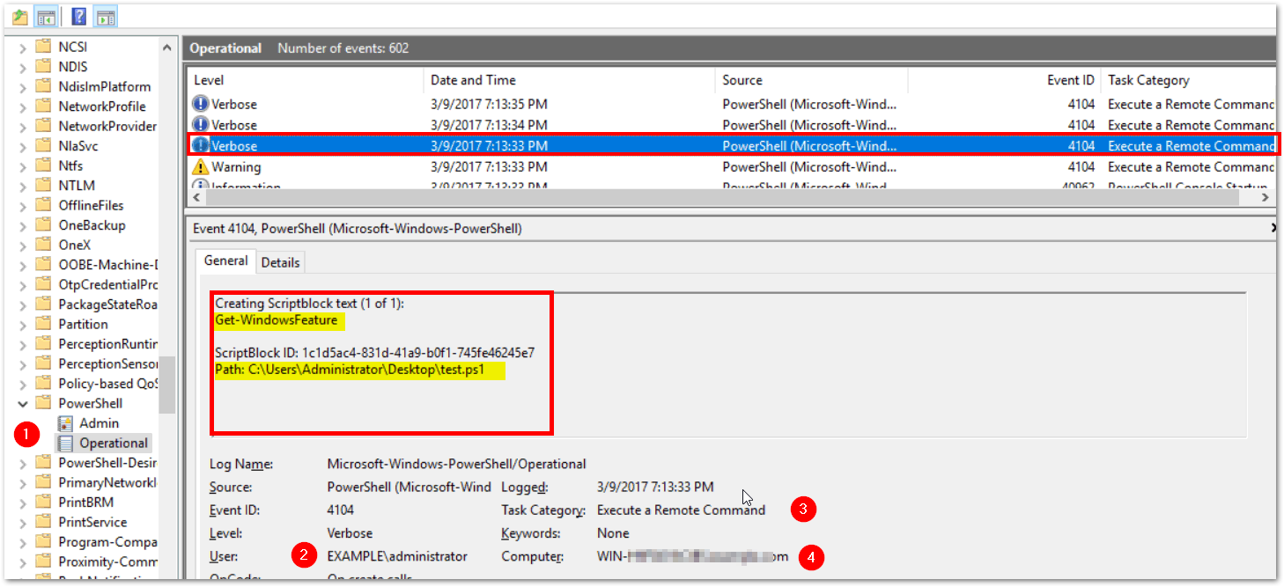
Powershell Logging: SCRIPT block Logging

Slide 43
Powershell Logging: TRANSCRIPTION
Transcription creates a unique record of every PowerShell session, including all input and output, exactly as it appears in the session.
Transcripts are written to text files, broken out by user and session.
WARNING: Transcription will capture passwords to the log in clear text!

Slide 44
Powershell Logging: TRANSCRIPTION
A common config for transcription is to write the logs to a local folder on each pc you want to capture history on.
Then, create a scheduled task that sweeps the logs off each machine into a share on a server once a day.
Finally compress the text files in a daily zipped archive.

Slide 45
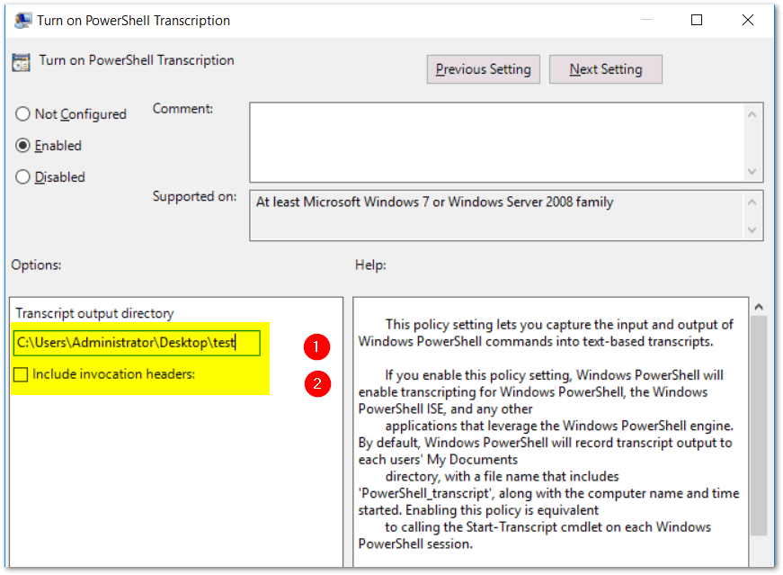
PowerShell Logging: Transcription
Notes:
Transcription starts when the session is created
Invocation headers will recording the start of each cmd invoked

Slide 46
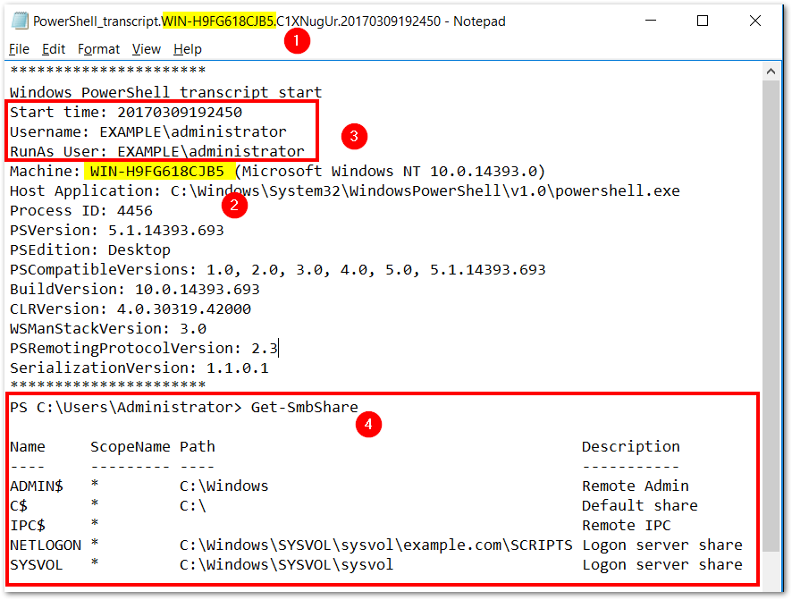
PowerShell Logging: Transcription

Slide 47
PSLogging: Summary
Three different logging options
Two options write to event logs
Transcription produces flat text files
Logging can fill up the eventlog quickly. Increase log size to 1GB or greater if possible
The right combination of logging is determined by you

Slide 48
PS REMOTING & LOGGING: Wrapping it all up
How secure PowerShell Remoting is depends on your security posture on your end nodes
PS Remoting uses secure protocols and AD authentication
PS Remoting can be configured easily via Group Policy
You can capture nearly every PS command typed into a PowerShell cmd prompt from any PC in your domain if you choose so. But doing so has an impact.
There is no one size fits all setting for PS Remoting & Logging
PS Remoting is safe and you should be enabling it!

Slide 49

PS Saturday: Raleigh
NC State Campus: Sept 21st & 22nd
18 speakers
Sunday: CyberOps & PowerShell 6 hr deep dive on offensive & defensive tactics
www.rtpsug.com/pssaturday

Slide 50

Thank you !

